Slide 1
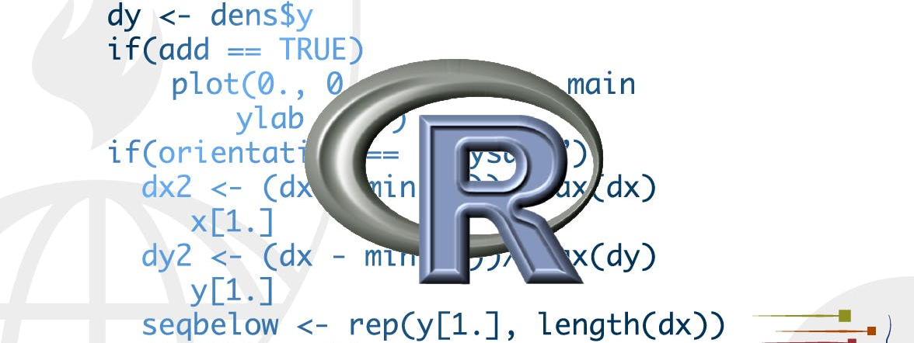
Data Transformation with dplyr
STA 4233 Introduction to Programming and Data Management in R
Notes:
Visualization is an important tool for insight generation, but it is rare that you get the data in exactly the right form you need. Often you’ll need to create some new variables or summaries, or maybe you just want to rename the variables or reorder the observations in order to make the data a little easier to work with. You’ll learn how to do all that (and more!) in this lecture, which will teach you how to transform your data using the dplyr package and a new dataset on flights departing New York City in 2013.

Slide 2

Prerequisites
library(nycflights13)
library(tidyverse)
-- Conflicts ----- tidyverse_conflicts() –
x dplyr::filter() masks stats::filter()
x dplyr::lag() masks stats::lag()
Notes:
In this lecture we’re going to focus on how to use the dplyr package, another core member of the tidyverse. We’ll illustrate the key ideas using data from the nycights13 package, and use ggplot2 to help us understand the data.
library(nycflights13)
library(tidyverse)
Take careful note of the conflicts message that’s printed when you load the tidyverse. It tells you that dplyr overwrites some functions in base R. If you want to use the base version of these functions after loading dplyr, you’ll need to use their full names: stats::filter() and stats::lag().

Slide 3
nycflight13
flights
# A tibble: 336,776 x 19
year month day dep_time sched_dep_time dep_delay
<int> <int> <int> <int> <int> <dbl>
1 2013 1 1 517 515 2
2 2013 1 1 533 529 4
3 2013 1 1 542 540 2
4 2013 1 1 544 545 -1
5 2013 1 1 554 600 -6
6 2013 1 1 554 558 -4
7 2013 1 1 555 600 -5
8 2013 1 1 557 600 -3
9 2013 1 1 557 600 -3
10 2013 1 1 558 600 -2
# ... with 336,766 more rows, and 13 more variables:
# arr_time <int>, sched_arr_time <int>,
# arr_delay <dbl>, carrier <chr>, flight <int>,
# tailnum <chr>, origin <chr>, dest <chr>,
# air_time <dbl>, distance <dbl>, hour <dbl>,
# minute <dbl>, time_hour <dttm>
Other variable types
<lgl>
<fctr>
<date>
http://bit.ly/transstats
Notes:
To explore the basic data manipulation verbs of dplyr, we’ll use nycflights13::flights. This data frame contains all 336,776 flights that departed from New York City in 2013. The data comes from the US Bureau of Transportation Statistics, and is documented in ?flights:
You might notice that this data frame prints a little differently from other data frames you might have used in the past: it only shows the first few rows and all the columns that fit on one screen. (To see the whole dataset, you can run View(flights), which will open the dataset in the RStudio viewer.) It prints differently because it’s a tibble. Tibbles are data frames, but slightly tweaked to work better in the tidyverse. For now, you don’t need to worry about the differences; we’ll come back to tibbles in more detail in Part II of the course.
You might also have noticed the row of three- (or four-) letter abbreviations under the column names. These describe the type of each variable:
int stands for integers.
dbl stands for doubles, or real numbers.
chr stands for character vectors, or strings.
dttm stands for date-times (a date + a time).
There are three other common types of variables that aren’t used in this dataset but you’ll encounter later in the book:
lgl stands for logical, vectors that contain only TRUE or FALSE.
fctr stands for factors, which R uses to represent categorical variables with fixed possible values.
date stands for dates.

Slide 4
dplyr Basics
Pick observations by their values (filter()).
Reorder the rows (arrange()).
Pick variables by their names (select()).
Create new variables with functions of existing variables (mutate()).
Collapse many values down to a single summary (summarize()).
group_by()
Notes:
In this lecture you are going to learn the five key dplyr functions that allow you to solve the vast majority of your data-manipulation challenges:
These can all be used in conjunction with group_by(), which changes the scope of each function from operating on the entire dataset to operating on it group-by-group. These six functions pro‐ vide the verbs for a language of data manipulation.

Slide 5
dplyr Basics
All verbs work similarly:
The first argument is a data frame.
The subsequent arguments describe what to do with the data frame, using the variable names (without quotes).
The result is a new data frame.
Notes:
Together these properties make it easy to chain together multiple simple steps to achieve a complex result. Let’s dive in and see how these verbs work.

Slide 6
Filter rows with filter()
filter(flights, month == 1, day == 1)
# A tibble: 842 x 19
year month day dep_time sched_dep_time dep_delay arr_time sched_arr_time arr_delay carrier flight tailnum
<int> <int> <int> <int> <int> <dbl> <int> <int> <dbl> <chr> <int> <chr>
1 2013 1 1 517 515 2 830 819 11 UA 1545 N14228
2 2013 1 1 533 529 4 850 830 20 UA 1714 N24211
3 2013 1 1 542 540 2 923 850 33 AA 1141 N619AA
4 2013 1 1 544 545 -1 1004 1022 -18 B6 725 N804JB
5 2013 1 1 554 600 -6 812 837 -25 DL 461 N668DN
6 2013 1 1 554 558 -4 740 728 12 UA 1696 N39463
7 2013 1 1 555 600 -5 913 854 19 B6 507 N516JB
8 2013 1 1 557 600 -3 709 723 -14 EV 5708 N829AS
9 2013 1 1 557 600 -3 838 846 -8 B6 79 N593JB
10 2013 1 1 558 600 -2 753 745 8 AA 301 N3ALAA
# ... with 832 more rows, and 7 more variables: origin <chr>, dest <chr>, air_time <dbl>, distance <dbl>,
# hour <dbl>, minute <dbl>, time_hour <dttm>
jan1 <- filter(flights, month == 1, day == 1)
(dec25 <- filter(flights, month == 12, day == 25))
Notes:
filter() allows you to subset observations based on their values. The first argument is the name of the data frame. The second and subsequent arguments are the expressions that filter the data frame. For example, we can select all flights on January 1st with:
(1) When you run that line of code, dplyr executes the filtering opera‐ tion and returns a new data frame. dplyr functions never modify their inputs, so if you want to save the result, you’ll need to use the assignment operator, <-:
(2) R either prints out the results, or saves them to a variable. If you want to do both, you can wrap the assignment in parentheses:

Slide 7
Comparisons
R provides the standard suite:
> | greater than
>= | greater than or equal
< | less than
<= | less than or equal
!= | not equal
== | equal
filter(flights, month = 1)
#> Error: filter() takes unnamed arguments. Do you need `==`?
Notes:
To use filtering effectively, you have to know how to select the obser‐ vations that you want using the comparison operators. R provides the standard suite: >, >=, <=, != (not equal), and == (equal).
When you’re starting out with R, the easiest mistake to make is to use = instead of == when testing for equality. When this happens you’ll get an informative error:

Slide 8
Comparisons
sqrt(2) ^ 2 == 2
#> [1] FALSE
1/49 * 49 == 1
#> [1] FALSE
near(sqrt(2) ^ 2, 2)
#> [1] TRUE
near(1/49 * 49, 1)
#> [1] TRUE
Notes:
There’s another common problem you might encounter when using ==: floating-point numbers. These results might surprise you! sqrt(2) ^ 2 == 2 #> [1] FALSE 1/49 * 49 == 1 #> [1] FALSE Computers use finite precision arithmetic (they obviously can’t store an infinite number of digits!) so remember that every number you see is an approximation. Instead of relying on ==, use near(): near(sqrt(2) ^ 2, 2) #> [1] TRUE near(1 / 49 * 49, 1) #> [1] TRUE

Slide 9
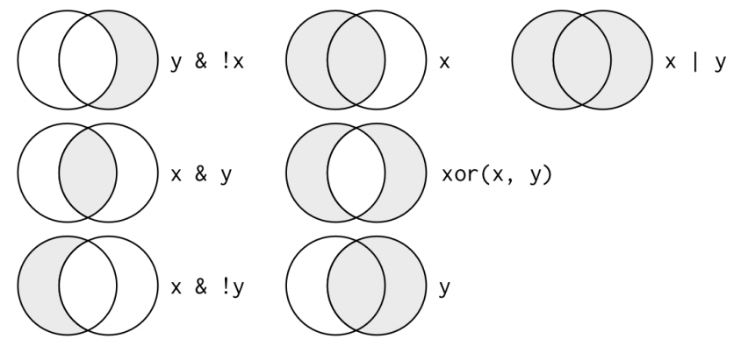
Logical Operators
“and”
“not”
“or”
Notes:
Multiple arguments to filter() are combined with “and”: every expression must be true in order for a row to be included in the output. For other types of combinations, you’ll need to use Boolean operators yourself: & is “and,” | is “or,” and ! is “not.” The following figure shows the complete set of Boolean operations.

Slide 10
Logical Operators
filter(flights, month == 11 | month == 12)
filter(flights, month == 11 | 12)
nov_dec <- filter(flights, month %in% c(11, 12))
Notes:
The following code finds all flights that departed in November or December:
The order of operations doesn’t work like English. You can’t write filter(flights, month == 11 | 12), which you might literally translate into “finds all flights that departed in November or December.” Instead it finds all months that equal 11 | 12, an expression that evaluates to TRUE. In a numeric context (like here), TRUE becomes one, so this finds all flights in January, not November or December. This is quite confusing!
A useful shorthand for this problem is x %in% y. This will select every row where x is one of the values in y. We could use it to rewrite the preceding code:

Slide 11
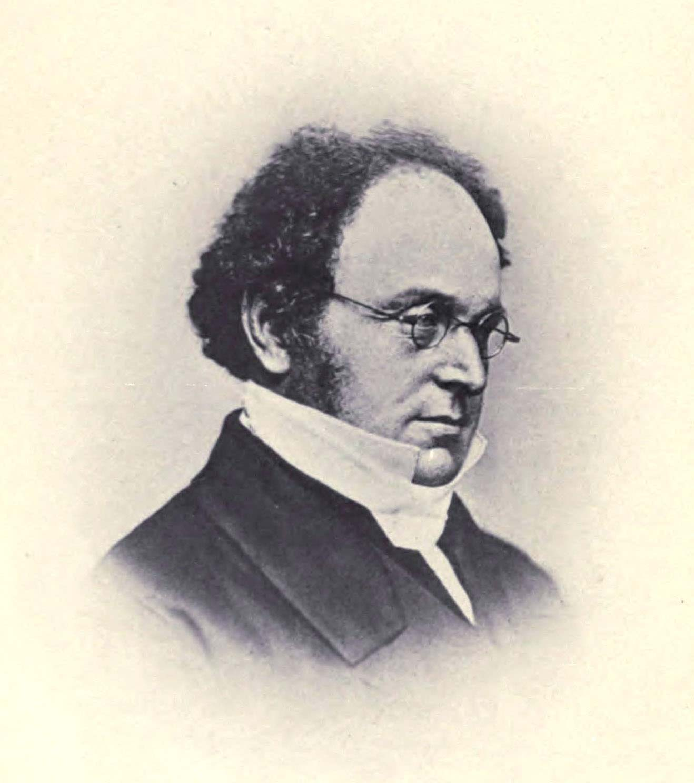
Logical Operators
De Morgan’s law:
!(x & y) is the same as !x | !y,
!(x | y) is the same as !x & !y.
filter(flights, !(arr_delay > 120 | dep_delay > 120))
filter(flights, arr_delay <= 120, dep_delay <= 120)
Notes:
Sometimes you can simplify complicated subsetting by remembering De Morgan’s law: !(x & y) is the same as !x | !y, and !(x | y) is the same as !x & !y. For example, if you wanted to find flights that weren’t delayed (on arrival or departure) by more than two hours, you could use either of the following two filters:
As well as & and |, R also has && and ||. Don’t use them here!
Whenever you start using complicated, multipart expressions in filter(), consider making them explicit variables instead. That makes it much easier to check your work. You’ll learn how to create new variables shortly

Slide 12
Missing Values
NA > 5
#> [1] NA
10 == NA
#> [1] NA
NA + 10
#> [1] NA
NA / 2
#> [1] NA
The most confusing result is this one:
NA == NA
#> [1] NA
Notes:
One important feature of R that can make comparison tricky is missing values, or NAs (“not availables”). NA represents an unknown value so missing values are “contagious”; almost any operation involving an unknown value will also be unknown:

Slide 13
Missing Values
It’s easiest to understand why this is true with a bit more context:
# Let x be Mary's age. We don't know how old she is.
x <- NA
# Let y be John's age. We don't know how old he is.
y <- NA
# Are John and Mary the same age?
x == y
#> [1] NA
# We don't know!
If you want to determine if a value is missing, use is.na():
is.na(x)
#> [1] TRUE

Slide 14
Missing Values
df <- tibble(x = c(1, NA, 3))
filter(df, x > 1)
#> # A tibble: 1 × 1
#> x
#> <dbl>
#> 1 3
filter(df, is.na(x) | x > 1)
#> # A tibble: 2 × 1
#> x
#> <dbl>
#> 1 NA
#> 2 3
Notes:
filter() only includes rows where the condition is TRUE; it excludes both FALSE and NA values. If you want to preserve missing values, ask for them explicitly:

Slide 15
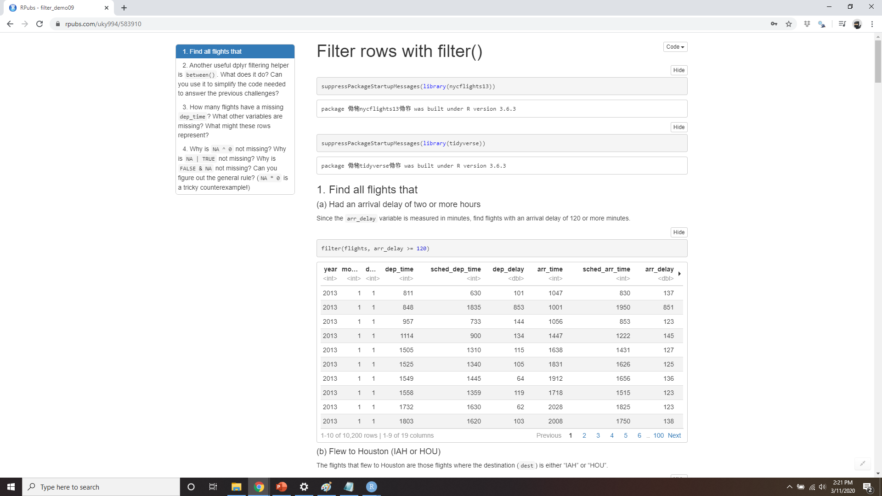
DEMO FILTER ROWS WITH FILTER()
Notes:
https://rpubs.com/uky994/583910
Find all flights that:
Had an arrival delay of two or more hours
Flew to Houston (IAH or HOU)
Were operated by United, American, or Delta
Departed in summer (July, August, and September)
Arrived more than two hours late, but didn’t leave late
Were delayed by at least an hour, but made up over 30 minutes in flight
Departed between midnight and 6 a.m. (inclusive)
Another useful dplyr filtering helper is between(). What does it do? Can you use it to simplify the code needed to answer the previous challenges?
How many flights have a missing dep_time? What other variables are missing? What might these rows represent?
Why is NA ^ 0 not missing? Why is NA | TRUE not missing? Why is FALSE & NA not missing? Can you figure out the general rule? (NA * 0 is a tricky counterexample!)

Slide 16
Arrange Rows with arrange()
arrange(flights, year, month, day)
# A tibble: 336,776 x 19
year month day dep_time sched_dep_time dep_delay arr_time sched_arr_time arr_delay carrier flight tailnum
<int> <int> <int> <int> <int> <dbl> <int> <int> <dbl> <chr> <int> <chr>
1 2013 1 1 517 515 2 830 819 11 UA 1545 N14228
2 2013 1 1 533 529 4 850 830 20 UA 1714 N24211
3 2013 1 1 542 540 2 923 850 33 AA 1141 N619AA
4 2013 1 1 544 545 -1 1004 1022 -18 B6 725 N804JB
5 2013 1 1 554 600 -6 812 837 -25 DL 461 N668DN
6 2013 1 1 554 558 -4 740 728 12 UA 1696 N39463
7 2013 1 1 555 600 -5 913 854 19 B6 507 N516JB
8 2013 1 1 557 600 -3 709 723 -14 EV 5708 N829AS
9 2013 1 1 557 600 -3 838 846 -8 B6 79 N593JB
10 2013 1 1 558 600 -2 753 745 8 AA 301 N3ALAA
# ... with 336,766 more rows, and 7 more variables: origin <chr>, dest <chr>, air_time <dbl>, distance <dbl>,
# hour <dbl>, minute <dbl>, time_hour <dttm>
1
2
3
Notes:
arrange() works similarly to filter() except that instead of selecting rows, it changes their order. It takes a data frame and a set of column names (or more complicated expressions) to order by. If you provide more than one column name, each additional column will be used to break ties in the values of preceding columns:
In this example I’m sorting the flights data set by year, month, then day, so the resulting table is sorting in year order first, then month order within year, then day order within month

Slide 17
Arrange Rows with arrange()
largest value first
Use desc() to reorder by a column in descending order:
arrange(flights, desc(arr_delay))
# A tibble: 336,776 x 19
year month day dep_time sched_dep_time dep_delay arr_time sched_arr_time arr_delay carrier flight tailnum
<int> <int> <int> <int> <int> <dbl> <int> <int> <dbl> <chr> <int> <chr>
1 2013 1 9 641 900 1301 1242 1530 1272 HA 51 N384HA
2 2013 6 15 1432 1935 1137 1607 2120 1127 MQ 3535 N504MQ
3 2013 1 10 1121 1635 1126 1239 1810 1109 MQ 3695 N517MQ
4 2013 9 20 1139 1845 1014 1457 2210 1007 AA 177 N338AA
5 2013 7 22 845 1600 1005 1044 1815 989 MQ 3075 N665MQ
6 2013 4 10 1100 1900 960 1342 2211 931 DL 2391 N959DL
7 2013 3 17 2321 810 911 135 1020 915 DL 2119 N927DA
8 2013 7 22 2257 759 898 121 1026 895 DL 2047 N6716C
9 2013 12 5 756 1700 896 1058 2020 878 AA 172 N5DMAA
10 2013 5 3 1133 2055 878 1250 2215 875 MQ 3744 N523MQ
# ... with 336,766 more rows, and 7 more variables: origin <chr>, dest <chr>, air_time <dbl>, distance <dbl>,
# hour <dbl>, minute <dbl>, time_hour <dttm>
Notes:
Use desc() to reorder by a column in descending order:

Slide 18
Arrange Rows with arrange()
Missing values are always sorted at the end:
df <- tibble(x = c(5, 2, NA))
arrange(df, x)
#> # A tibble: 3 × 1
#> x
#> <dbl>
#> 1 2
#> 2 5
#> 3 NA
arrange(df, desc(x))
#> # A tibble: 3 × 1
#> x
#> <dbl>
#> 1 5
#> 2 2
#> 3 NA
Notes:
Missing values are always sorted at the end:

Slide 19
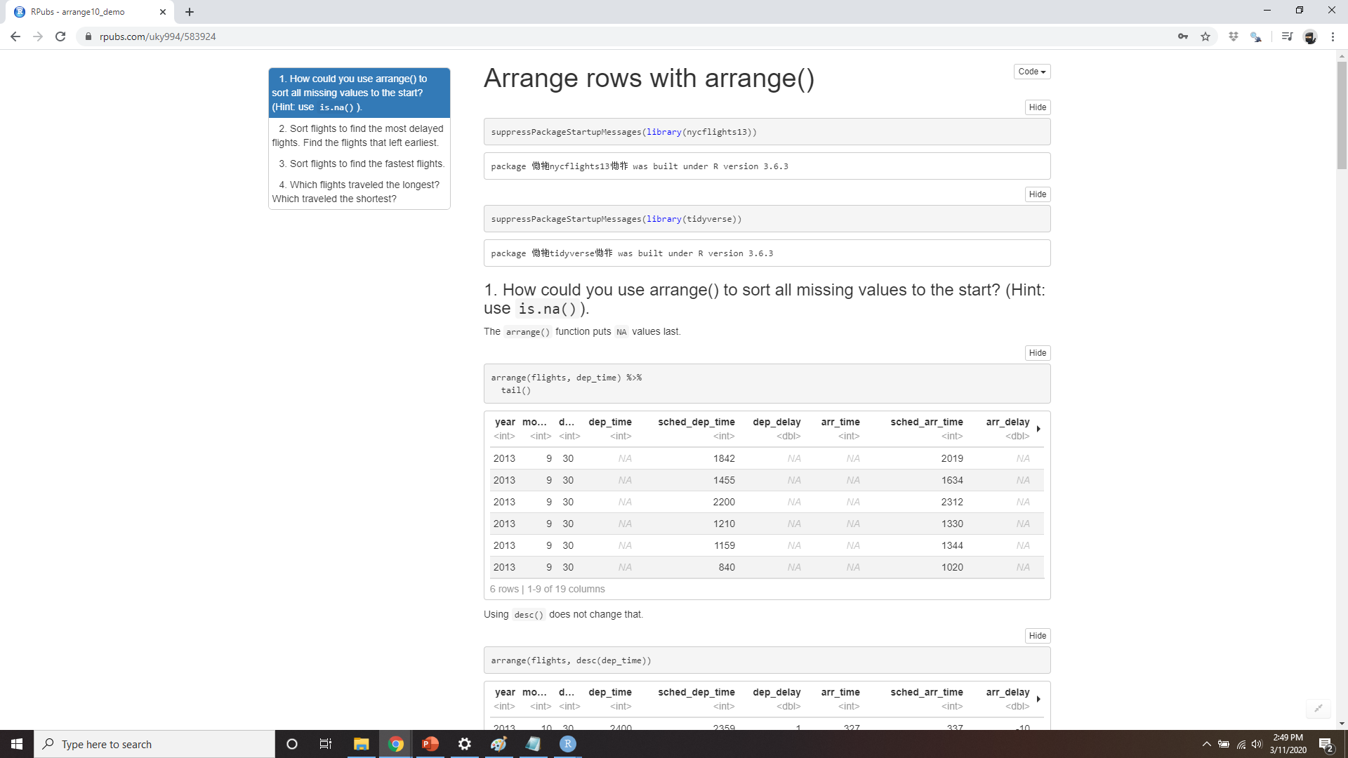
DEMO ARRANGE ROWS WITH Arrange()
Notes:
https://rpubs.com/uky994/583924
How could you use arrange() to sort all missing values to the start? (Hint: use is.na().)
Sort flights to find the most delayed flights. Find the flights that left earliest.
Sort flights to find the fastest flights.
Which flights traveled the longest? Which traveled the shortest?

Slide 20
Select Columns with select()
# Select columns by name
select(flights, year, month, day)
#> # A tibble: 336,776 × 3
#> year month day
#> <int> <int> <int>
#> 1 2013 1 1
#> 2 2013 1 1
#> 3 2013 1 1
#> 4 2013 1 1
#> 5 2013 1 1
#> 6 2013 1 1
#> # ... with 3.368e+05 more rows
Notes:
It’s not uncommon to get datasets with hundreds or even thousands of variables. In this case, the first challenge is often narrowing in on the variables you’re actually interested in. select() allows you to rapidly zoom in on a useful subset using operations based on the names of the variables.
select() is not terribly useful with the flight data because we only have 19 variables, but you can still get the general idea:

Slide 21
Select Columns with select()
# Select all columns between year and day (inclusive)
select(flights, year:day)
#> # A tibble: 336,776 × 3
#> year month day
#> <int> <int> <int>
#> 1 2013 1 1
#> 2 2013 1 1
#> 3 2013 1 1
#> 4 2013 1 1
#> 5 2013 1 1
#> 6 2013 1 1
#> # ... with 3.368e+05 more rows

Slide 22
Select Columns with select()
# Select all columns except those from year to day (inclusive) select(flights, -(year:day))
#> # A tibble: 336,776 × 16
#> dep_time sched_dep_time dep_delay arr_time sched_arr_time
#> <int> <int> <dbl> <int> <int>
#> 1 517 515 2 830 819
#> 2 533 529 4 850 830
#> 3 542 540 2 923 850
#> 4 544 545 -1 1004 1022
#> 5 554 600 -6 812 837
#> 6 554 558 -4 740 728
#> # ... with 3.368e+05 more rows, and 12 more variables: #> # arr_delay , carrier , flight , #> # tailnum , origin , dest , air_time , #> # distance , hour , minute , #> # time_hour

Slide 23
Helper functions for select()
There are a number of helper functions you can use within select():
starts_with("abc") matches names that begin with “abc”.
ends_with("xyz") matches names that end with “xyz”.
contains("ijk") matches names that contain “ijk”.
matches("(.)\\1") selects variables that match a regular expression.
num_range("x", 1:3) matches x1, x2, and x3.
See ?select for more details.
Notes:
This regular expression matches any variables that contain repeated characters. You’ll learn more about regular expressions in Chapter 11.

Slide 24
Rename()
rename(flights, tail_num = tailnum)
#> # A tibble: 336,776 × 19
#> year month day dep_time sched_dep_time dep_delay
#> <int> <int><int> <int> <int> <dbl>
#> 1 2013 1 1 517 515 2
#> 2 2013 1 1 533 529 4
#> 3 2013 1 1 542 540 2
#> 4 2013 1 1 544 545 -1
#> 5 2013 1 1 554 600 -6
#> 6 2013 1 1 554 558 -4
#> # ... with 3.368e+05 more rows, and 13 more variables:
#> # arr_time , sched_arr_time , arr_delay , carrier , flight, #> # tail_num , #> # origin , dest , air_time , distance ,
#> # hour , minute , #> # time_hour
Notes:
select() can be used to rename variables, but it’s rarely useful because it drops all of the variables not explicitly mentioned. Instead, use rename(), which is a variant of select() that keeps all the variables that aren’t explicitly mentioned:

Slide 25
Select Columns with select()
select(flights, time_hour, air_time, everything())
#> # A tibble: 336,776 × 19
#> time_hour air_time year month day dep_time
#> <dttm> <dbl> <int> <int> <int> <int>
#> 1 2013-01-01 05:00:00 227 2013 1 1 517
#> 2 2013-01-01 05:00:00 227 2013 1 1 533
#> 3 2013-01-01 05:00:00 160 2013 1 1 542
#> 4 2013-01-01 05:00:00 183 2013 1 1 544
#> 5 2013-01-01 06:00:00 116 2013 1 1 554
#> 6 2013-01-01 05:00:00 150 2013 1 1 554
#> # ... with 3.368e+05 more rows, and 13 more variables:
#> # sched_dep_time <int>, dep_delay <dbl>, arr_time <int>,
#> # sched_arr_time <int>, arr_delay <dbl>, carrier <chr>,
#> # flight <int>, tailnum <chr>, origin <chr>, dest <chr>,
#> # distance <dbl>, hour <dbl>, minute <dbl>
Notes:
Another option is to use select() in conjunction with the everything() helper. This is useful if you have a handful of variables you’d like to move to the start of the data frame:

Slide 26
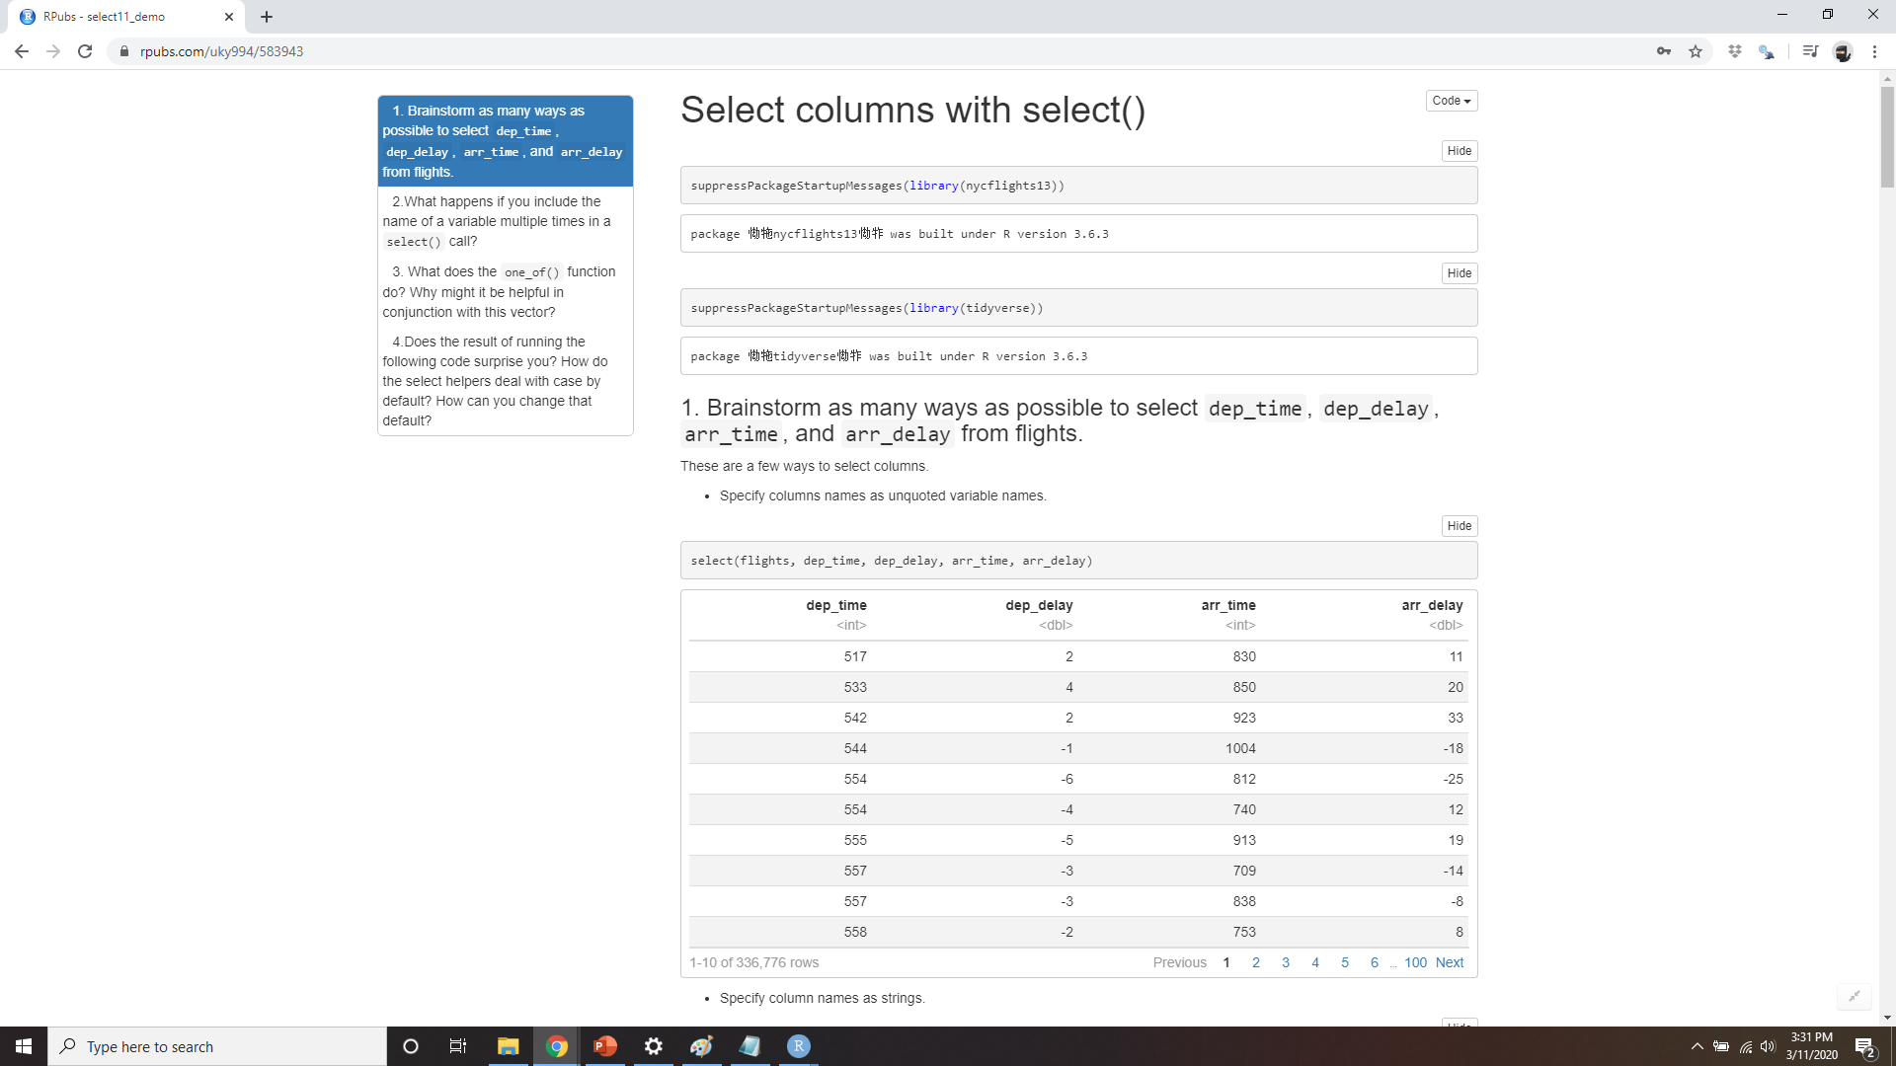
DEMO select ROWS WITH select()
Notes:
https://rpubs.com/uky994/583943
Brainstorm as many ways as possible to select dep_time, dep_delay, arr_time, and arr_delay from flights.
What happens if you include the name of a variable multiple times in a select() call?
What does the one_of() function do? Why might it be helpful in conjunction with this vector? vars <- c( "year", "month", "day", "dep_delay", "arr_delay" )
Does the result of running the following code surprise you? How do the select helpers deal with case by default? How can you change that default? select(flights, contains("TIME"))

Slide 27
Add New Variables with mutate()
flights_sml <- select(flights,
year:day,
ends_with("delay"),
distance,
air_time
)
mutate(flights_sml,
gain = arr_delay - dep_delay,
speed = distance / air_time * 60
)
#> # A tibble: 336,776 × 9
#> year month day dep_delay arr_delay distance air_time
#> <int> <int> <int> <dbl> <dbl> <dbl> <dbl>
#> 1 2013 1 1 2 11 1400 227
#> 2 2013 1 1 4 20 1416 227
#> 3 2013 1 1 2 33 1089 160
#> # ... with 3.368e+05 more rows, and 2 more variables:
#> # gain <dbl>, speed <dbl>
Notes:
Besides selecting sets of existing columns, it’s often useful to add new columns that are functions of existing columns. That’s the job of mutate().
mutate() always adds new columns at the end of your dataset so we’ll start by creating a narrower dataset so we can see the new vari‐ ables. Remember that when you’re in RStudio, the easiest way to see all the columns is View():

Slide 28
Add New Variables with mutate()
Note that you can refer to columns that you’ve just created:
mutate(flights_sml,
gain = arr_delay - dep_delay,
hours = air_time / 60,
gain_per_hour = gain / hours
)
#> # A tibble: 336,776 × 10
#> year month day dep_delay arr_delay distance air_time
#> <int> <int> <int> <dbl> <dbl> <dbl> <dbl>
#> 1 2013 1 1 2 11 1400 227
#> 2 2013 1 1 4 20 1416 227
#> 3 2013 1 1 2 33 1089 160
#> 4 2013 1 1 -1 -18 1576 183
#> # ... with 3.368e+05 more rows, and 3 more variables:
#> # gain <dbl>, hours <dbl>, gain_per_hour <dbl>
Notes:
Here I’ve used an assignment statement to create gain to be the difference between arrival delay and departure delay, but I’ve also called it in the assignment statement for gain per hour.

Slide 29
Add New Variables with mutate()
If you only want to keep the new variables, use transmute():
transmute(flights,
gain = arr_delay - dep_delay,
hours = air_time / 60,
gain_per_hour = gain / hours
)
#> # A tibble: 336,776 × 3
#> gain hours gain_per_hour
#> <dbl> <dbl> <dbl>
#> 1 9 3.78 2.38
#> 2 16 3.78 4.23
#> 3 31 2.67 11.62
#> 4 -17 3.05 -5.57
#> 5 -19 1.93 -9.83
#> # ... with 3.368e+05 more rows
Notes:
Transmute is sort of like mutate and select

Slide 30
Useful Creation Functions
Arithmetic operators +, -, *, /, ^
Modular arithmetic (%/% and %%)
Logs log(), log2(), log10()
Offsets
Cumulative and rolling aggregates
Logical comparisons <=, >, >=, !=
Ranking
Notes:
There are many functions for creating new variables that you can use with mutate(). The key property is that the function must be vectorized: it must take a vector of values as input, and return a vec‐ tor with the same number of values as output. There’s no way to list every possible function that you might use, but here’s a selection of functions that are frequently useful:

Slide 31
Arithmetic operators +, -, *, /, ^
air_time / 60
hours * 60 + minute
Useful in conjunction with the aggregate functions
x / sum(x) calculates the proportion of a total, and
y - mean(y) computes the difference from the mean.
Notes:
These are all vectorized, using the so-called “recycling rules.” If one parameter is shorter than the other, it will be automatically extended to be the same length. This is most useful when one of the arguments is a single number: air_time / 60, hours * 60 + minute, etc. Arithmetic operators are also useful in conjunction with the aggregate functions you’ll learn about later. For example, x / sum(x) calculates the proportion of a total, and y - mean(y) computes the difference from the mean.

Slide 32
Modular arithmetic (%/% and %%)
transmute(flights,
dep_time,
hour = dep_time %/% 100,
minute = dep_time %% 100
)
#> # A tibble: 336,776 × 3
#> dep_time hour minute
#> <int> <dbl> <dbl>
#> 1 517 5 17
#> 2 533 5 33
#> 3 542 5 42
#> 4 544 5 44
#> 5 554 5 54
#> 6 554 5 54
#> # ... with 3.368e+05 more rows
Notes:
%/% (integer division) and %% (remainder), where x == y * (x %/% y) + (x %% y). Modular arithmetic is a handy tool because it allows you to break integers into pieces. For example, in the flights dataset, you can compute hour and minute from dep_time with:

Slide 33
Logs log(), log2(), log10()
Useful for dealing with data that ranges across multiple orders of magnitude
Convert multiplicative relationships to additive
I like log2()
Notes:
Logarithms are an incredibly useful transformation for dealing with data that ranges across multiple orders of magnitude. They also convert multiplicative relationships to additive, a feature we’ll come back to in Part IV. All else being equal, I recommend using log2() because it’s easy to interpret: a difference of 1 on the log scale corresponds to doubling on the original scale and a difference of –1 corresponds to halving.

Slide 34
offsets
(x <- 1:10)
#> [1] 1 2 3 4 5 6 7 8 9 10
lag(x)
#> [1] NA 1 2 3 4 5 6 7 8 9
lead(x)
#> [1] 2 3 4 5 6 7 8 9 10 NA
Notes:
lead() and lag() allow you to refer to leading or lagging values. This allows you to compute running differences (e.g., x - lag(x)) or find when values change (x != lag(x)). They are most useful in conjunction with group_by(), which you’ll learn about shortly:

Slide 35
Cumulative and rolling aggregates
x
#> [1] 1 2 3 4 5 6 7 8 9 10
cumsum(x)
#> [1] 1 3 6 10 15 21 28 36 45 55
cummean(x)
#> [1] 1.0 1.5 2.0 2.5 3.0 3.5 4.0 4.5 5.0 5.5
Notes:
R provides functions for running sums, products, mins, and maxes: cumsum(), cumprod(), cummin(), cummax(); and dplyr provides cummean() for cumulative means. If you need rolling aggregates (i.e., a sum computed over a rolling window), try the RcppRoll package:

Slide 36

Logical comparisons <=, >, >=, !=
https://www.geeksforgeeks.org/i-cant-use-logic-in-programming-what-should-i-do/
Notes:
If you’re doing a complex sequence of logical operations it’s often a good idea to store the interim values in new variables so you can check that each step is working as expected.

Slide 37
Ranking
y <- c(1, 2, 2, NA, 3, 4)
min_rank(y)
#> [1] 1 2 2 NA 4 5
min_rank(desc(y))
#> [1] 5 3 3 NA 2 1
row_number(y)
#> [1] 1 2 3 NA 4 5
dense_rank(y)
#> [1] 1 2 2 NA 3 4
percent_rank(y)
#> [1] 0.00 0.25 0.25 NA 0.75 1.00
cume_dist(y)
#> [1] 0.2 0.6 0.6 NA 0.8 1.0
Notes:
There are a number of ranking functions, but you should start with min_rank(). It does the most usual type of ranking (e.g., first, second, third, fourth). The default gives the smallest values the smallest ranks; use desc(x) to give the largest values the smallest ranks:
If min_rank() doesn’t do what you need, look at the variants row_number(), dense_rank(), percent_rank(), cume_dist(), and ntile(). See their help pages for more details:

Slide 38
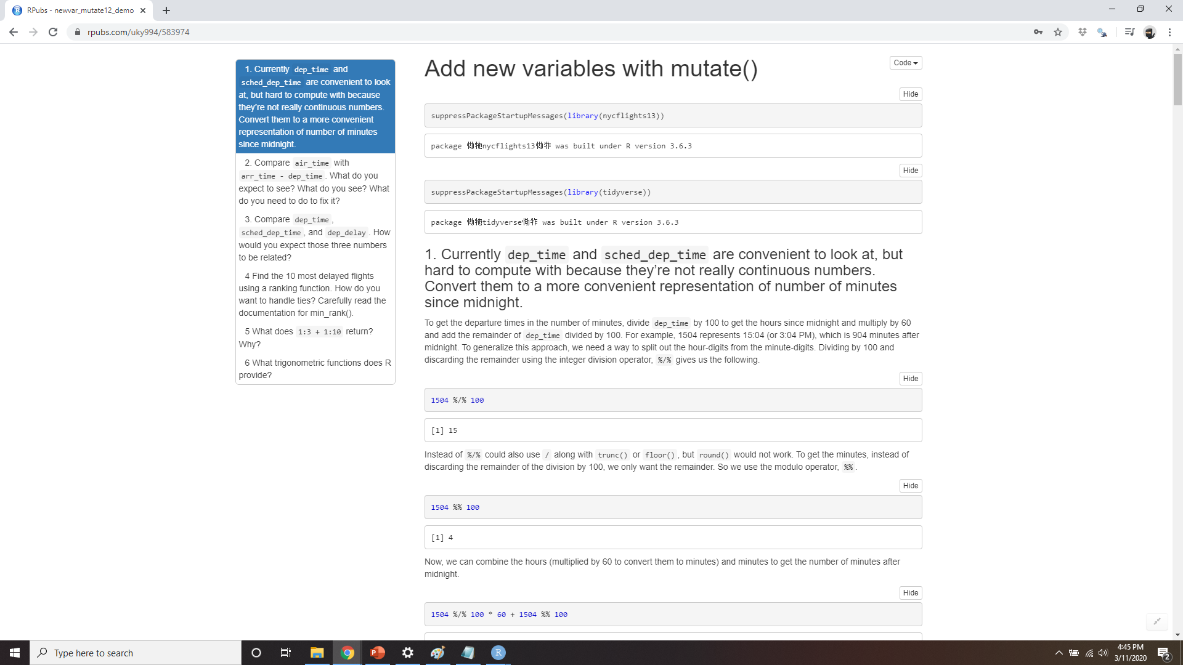
DEMO Add New Variables with mutate()
Notes:
https://rpubs.com/uky994/583974
Currently dep_time and sched_dep_time are convenient to look at, but hard to compute with because they’re not really continuous numbers. Convert them to a more convenient representation of number of minutes since midnight.
Compare air_time with arr_time - dep_time. What do you expect to see? What do you see? What do you need to do to fix it?
Compare dep_time, sched_dep_time, and dep_delay. How would you expect those three numbers to be related?
Find the 10 most delayed flights using a ranking function. How do you want to handle ties? Carefully read the documentation for min_rank().
What does 1:3 + 1:10 return? Why?
What trigonometric functions does R provide?

Slide 39
Grouped Summaries with summarize()
summarize(flights, delay = mean(dep_delay, na.rm = TRUE))
#> # A tibble: 1 × 1
#> delay
#> <dbl>
#> 1 12.6
Notes:
The last key verb is summarize(). It collapses a data frame to a single row:
(We’ll come back to what that na.rm = TRUE means very shortly.)

Slide 40
Grouped Summaries with summarize()
by_day <- group_by(flights, year, month, day)
summarize(by_day, delay = mean(dep_delay, na.rm = TRUE))
#> Source: local data frame [365 x 4]
#> Groups: year, month [?]
#>
#> year month day delay
#> <int> <int> <int> <dbl>
#> 1 2013 1 1 11.55
#> 2 2013 1 2 13.86
#> 3 2013 1 3 10.99
#> 4 2013 1 4 8.95
#> 5 2013 1 5 5.73
#> 6 2013 1 6 7.15
#> # ... with 359 more rows
Notes:
summarize() is not terribly useful unless we pair it with group_by(). This changes the unit of analysis from the complete dataset to individual groups. Then, when you use the dplyr verbs on a grouped data frame they’ll be automatically applied “by group.” For example, if we applied exactly the same code to a data frame grouped by date, we get the average delay per date:
Together group_by() and summarize() provide one of the tools that you’ll use most commonly when working with dplyr: grouped summaries. But before we go any further with this, we need to introduce a powerful new idea: the pipe.

Slide 41
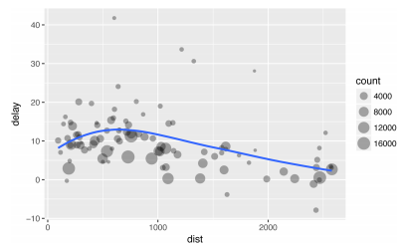
Combining Multiple Operations with the Pipe
by_dest <- group_by(flights, dest)
delay <- summarize(by_dest,
count = n(),
dist = mean(distance, na.rm = TRUE),
delay = mean(arr_delay, na.rm = TRUE)
)
delay <- filter(delay, count > 20, dest != "HNL")
# It looks like delays increase with distance up to ~750 miles
# and then decrease. Maybe as flights get longer there's more
# ability to make up delays in the air?
ggplot(data = delay, mapping = aes(x = dist, y = delay)) +
geom_point(aes(size = count), alpha = 1/3) +
geom_smooth(se = FALSE)
#> `geom_smooth()` using method = 'loess'
Notes:
Imagine that we want to explore the relationship between the distance and average delay for each location. Using what you know about dplyr, you might write code like this:

Slide 42
Combining Multiple Operations with the Pipe
There are three steps to prepare this data:
Group flights by destination.
Summarize to compute distance, average delay, and number of flights.
Filter to remove noisy points and Honolulu airport, which is almost twice as far away as the next closest airport.
Notes:
This code is a little frustrating to write because we have to give each intermediate data frame a name, even though we don’t care about it. Naming things is hard, so this slows down our analysis.

Slide 43
Combining Multiple Operations with the Pipe
There’s another way to tackle the same problem with the pipe, %>%:
delays <- flights %>%
group_by(dest) %>%
summarize(
count = n(),
dist = mean(distance, na.rm = TRUE),
delay = mean(arr_delay, na.rm = TRUE)
) %>%
filter(count > 20, dest != "HNL")
Notes:
This focuses on the transformations, not what’s being transformed, which makes the code easier to read. You can read it as a series of imperative statements: group, then summarize, then filter. As suggested by this reading, a good way to pronounce %>% when reading code is “then.”
Behind the scenes, x %>% f(y) turns into f(x, y), and x %>% f(y) %>% g(z) turns into g(f(x, y), z), and so on. You can use the pipe to rewrite multiple operations in a way that you can read left-toright, top-to-bottom. We’ll use piping frequently from now on because it considerably improves the readability of code, and we’ll come back to it in more detail later.
Working with the pipe is one of the key criteria for belonging to the tidyverse. The only exception is ggplot2: it was written before the pipe was discovered. Unfortunately, the next iteration of ggplot2, ggvis, which does use the pipe, isn’t ready for prime time yet.

Slide 44
Missing Values
flights %>%
group_by(year, month, day) %>%
summarize(mean = mean(dep_delay))
#> Source: local data frame [365 x 4]
#> Groups: year, month [?]
#>
#> year month day mean
#> <int> <int> <int> <dbl>
#> 1 2013 1 1 NA
#> 2 2013 1 2 NA
#> 3 2013 1 3 NA
#> 4 2013 1 4 NA
#> 5 2013 1 5 NA
#> 6 2013 1 6 NA
#> # ... with 359 more rows
Notes:
You may have wondered about the na.rm argument we used earlier. What happens if we don’t set it?
We get a lot of missing values! That’s because aggregation functions obey the usual rule of missing values: if there’s any missing value in the input, the output will be a missing value.

Slide 45
Missing Values
flights %>%
group_by(year, month, day) %>%
summarize(mean = mean(dep_delay, na.rm = TRUE))
#> Source: local data frame [365 x 4]
#> Groups: year, month [?]
#>
#> year month day mean
#> <int> <int> <int> <dbl>
#> 1 2013 1 1 11.55
#> 2 2013 1 2 13.86
#> 3 2013 1 3 10.99
#> 4 2013 1 4 8.95
#> 5 2013 1 5 5.73
#> 6 2013 1 6 7.15
#> # ... with 359 more rows
Notes:
Fortunately, all aggregation functions have an na.rm argument, which removes the miss‐ ing values prior to computation:
In this case, where missing values represent cancelled flights, we could also tackle the problem by first removing the cancelled flights.

Slide 46
Missing Values
not_cancelled <- flights %>%
filter(!is.na(dep_delay), !is.na(arr_delay))
not_cancelled %>%
group_by(year, month, day) %>%
summarize(mean = mean(dep_delay))
#> Source: local data frame [365 x 4]
#> Groups: year, month [?]
#>
#> year month day mean
#> <int> <int> <int> <dbl>
#> 1 2013 1 1 11.44
#> 2 2013 1 2 13.68
#> 3 2013 1 3 10.91
#> 4 2013 1 4 8.97
#> # ... with 361 more rows
Notes:
We’ll save this dataset so we can reuse it in the next few examples:

Slide 47
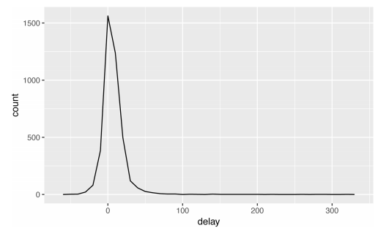
Counts
delays <- not_cancelled %>%
group_by(tailnum) %>%
summarize(
delay = mean(arr_delay)
)
ggplot(data = delays, mapping = aes(x = delay)) +
geom_freqpoly(binwidth = 10)
Notes:
Whenever you do any aggregation, it’s always a good idea to include either a count (n()), or a count of nonmissing values (sum(!is.na(x))). That way you can check that you’re not drawing conclusions based on very small amounts of data. For example, let’s look at the planes (identified by their tail number) that have the highest average delays:
Wow, there are some planes that have an average delay of 5 hours (300 minutes)!

Slide 48
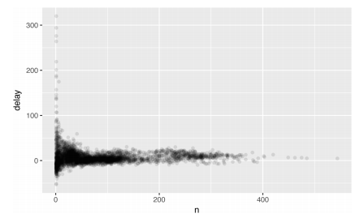
Counts
delays <- not_cancelled %>%
group_by(tailnum) %>%
summarize(
delay = mean(arr_delay, na.rm = TRUE),
n = n()
)
ggplot(data = delays, mapping = aes(x = n, y = delay)) +
geom_point(alpha = 1/10)
Notes:
The story is actually a little more nuanced. We can get more insight if we draw a scatterplot of number of flights versus average delay:
Not surprisingly, there is much greater variation in the average delay when there are few flights. The shape of this plot is very characteristic: whenever you plot a mean (or other summary) versus group size, you’ll see that the variation decreases as the sample size increases.

Slide 49
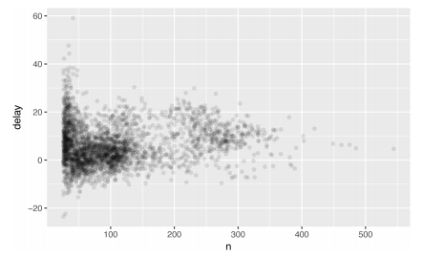
Counts
delays %>%
filter(n > 25) %>%
ggplot(mapping = aes(x = n, y = delay)) +
geom_point(alpha = 1/10)
Notes:
When looking at this sort of plot, it’s often useful to filter out the groups with the smallest numbers of observations, so you can see more of the pattern and less of the extreme variation in the smallest groups. This is what the following code does, as well as showing you a handy pattern for integrating ggplot2 into dplyr flows. It’s a bit painful that you have to switch from %>% to +, but once you get the hang of it, it’s quite convenient:

Slide 50
Useful Summary Functions
Measures of location
Measures of spread sd(x), IQR(x), mad(x)
Measures of rank min(x), quantile(x, 0.25), max(x)
Measures of position first(x), nth(x, 2), last(x)
Counts
Counts and proportions of logical values sum(x > 10), mean(y == 0)
Notes:
Just using means, counts, and sum can get you a long way, but R provides many other useful summary functions:

Slide 51
Measures of location
not_cancelled %>%
group_by(year, month, day) %>%
summarize(
# average delay:
avg_delay1 = mean(arr_delay),
# average positive delay:
avg_delay2 = mean(arr_delay[arr_delay > 0])
)
#> Source: local data frame [365 x 5]
#> Groups: year, month [?]
#>
#> year month day avg_delay1 avg_delay2
#> <int> <int> <int> <dbl> <dbl>
#> 1 2013 1 1 12.65 32.5
#> 2 2013 1 2 12.69 32.0
#> 3 2013 1 3 5.73 27.7
#> # ... with 362 more rows
Notes:
We’ve used mean(x), but median(x) is also useful. The mean is the sum divided by the length; the median is a value where 50% of x is above it, and 50% is below it
It’s sometimes useful to combine aggregation with logical subsetting. We haven’t talked about this sort of subsetting yet, but you’ll learn more about it later

Slide 52
Measures of spread sd(x), IQR(x), mad(x)
# Why is distance to some destinations more variable
# than to others?
not_cancelled %>%
group_by(dest) %>%
summarize(distance_sd = sd(distance)) %>%
arrange(desc(distance_sd))
#> # A tibble: 104 × 2
#> dest distance_sd
#> <chr> <dbl>
#> 1 EGE 10.54
#> 2 SAN 10.35
#> 3 SFO 10.22
#> 4 HNL 10.00
#> 5 SEA 9.98
#> 6 LAS 9.91
#> # ... with 98 more rows
Notes:
The mean squared deviation, or standard deviation or sd for short, is the standard measure of spread. The interquartile range IQR() and median absolute deviation mad(x) are robust equiva‐ lents that may be more useful if you have outliers:

Slide 53
Measures of rank min(x), quantile(x, 0.25), max(x)
# When do the first and last flights leave each day?
not_cancelled %>%
group_by(year, month, day) %>%
summarize(
first = min(dep_time),
last = max(dep_time)
)
#> Source: local data frame [365 x 5]
#> Groups: year, month [?]
#>
#> year month day first last
#> <int> <int> <int> <int> <int>
#> 1 2013 1 1 517 2356
#> 2 2013 1 2 42 2354
#> 3 2013 1 3 32 2349
#> # ... with 362 more rows
Notes:
Quantiles are a generalization of the median. For example, quan tile(x, 0.25) will find a value of x that is greater than 25% of the values, and less than the remaining 75%:

Slide 54
Measures of position first(x), nth(x, 2), last(x)
not_cancelled %>%
group_by(year, month, day) %>%
summarize(
first_dep = first(dep_time),
last_dep = last(dep_time)
)
#> Source: local data frame [365 x 5]
#> Groups: year, month [?]
#>
#> year month day first_dep last_dep
#> <int> <int> <int> <int> <int>
#> 1 2013 1 1 517 2356
#> 2 2013 1 2 42 2354
#> 3 2013 1 3 32 2349
#> 4 2013 1 4 25 2358
#> # ... with 361 more rows
Notes:
These work similarly to x[1], x[2], and x[length(x)] but let you set a default value if that position does not exist (i.e., you’re trying to get the third element from a group that only has two elements). For example, we can find the first and last departure for each day:

Slide 55
Measures of position first(x), nth(x, 2), last(x)
not_cancelled %>%
group_by(year, month, day) %>%
mutate(r = min_rank(desc(dep_time))) %>%
filter(r %in% range(r))
#> Source: local data frame [770 x 20]
#> Groups: year, month, day [365]
#>
#> year month day dep_time sched_dep_time dep_delay
#> <int> <int> <int> <int> <int> <dbl>
#> 1 2013 1 1 517 515 2
#> 2 2013 1 1 2356 2359 -3
#> # ... with 768 more rows, and 13 more variables:
#> # arr_time <int>, sched_arr_time <int>,
#> # arr_delay <dbl>, carrier <chr>, flight <int>,
#> # tailnum <chr>, origin <chr>, dest <chr>,
#> # air_time <dbl>, distance <dbl>, hour <dbl>,
#> # minute <dbl>, time_hour <dttm>, r <int>
Notes:
These functions are complementary to filtering on ranks. Filter‐ ing gives you all variables, with each observation in a separate row:

Slide 56
Counts
# Which destinations have the most carriers?
not_cancelled %>%
group_by(dest) %>%
summarize(carriers = n_distinct(carrier)) %>%
arrange(desc(carriers))
#> # A tibble: 104 × 2
#> dest carriers
#> <chr> <int>
#> 1 ATL 7
#> 2 BOS 7
#> 3 CLT 7
#> 4 ORD 7
#> 5 TPA 7
#> 6 AUS 6
#> # ... with 98 more rows
Notes:
You’ve seen n(), which takes no arguments, and returns the size of the current group. To count the number of non-missing val‐ ues, use sum(!is.na(x)). To count the number of distinct (unique) values, use n_distinct(x):

Slide 57
counts
not_cancelled %>%
count(dest)
#> # A tibble: 104 × 2
#> dest n
#> <chr> <int>
#> 1 ABQ 254
#> 2 ACK 264
#> 3 ALB 418
#> 4 ANC 8
#> 5 ATL 16837
#> 6 AUS 2411
#> # ... with 98 more rows
Notes:
Counts are so useful that dplyr provides a simple helper if all you want is a count:

Slide 58
counts
not_cancelled %>%
count(tailnum, wt = distance)
#> # A tibble: 4,037 × 2
#> tailnum n
#> <chr> <dbl>
#> 1 D942DN 3418
#> 2 N0EGMQ 239143
#> 3 N10156 109664
#> 4 N102UW 25722
#> 5 N103US 24619
#> 6 N104UW 24616
#> # ... with 4,031 more rows
Notes:
You can optionally provide a weight variable. For example, you could use this to “count” (sum) the total number of miles a plane flew:

Slide 59
Counts and proportions of logical values sum(x > 10), mean(y == 0)
# How many flights left before 5am? (these usually
# indicate delayed flights from the previous day)
not_cancelled %>%
group_by(year, month, day) %>%
summarize(n_early = sum(dep_time < 500))
#> Source: local data frame [365 x 4]
#> Groups: year, month [?]
#>
#> year month day n_early
#> <int> <int> <int> <int>
#> 1 2013 1 1 0
#> 2 2013 1 2 3
#> 3 2013 1 3 4
#> 4 2013 1 4 3
#> 5 2013 1 5 3
#> 6 2013 1 6 2
#> # ... with 359 more rows
Notes:
When used with numeric functions, TRUE is converted to 1 and FALSE to 0. This makes sum() and mean() very useful: sum(x) gives the number of TRUEs in x, and mean(x) gives the propor‐ tion: #

Slide 60
Counts and proportions of logical values sum(x > 10), mean(y == 0)
# What proportion of flights are delayed by more
# than an hour?
not_cancelled %>%
group_by(year, month, day) %>%
summarize(hour_perc = mean(arr_delay > 60))
#> Source: local data frame [365 x 4]
#> Groups: year, month [?]
#>
#> year month day hour_perc
#> <int> <int> <int> <dbl>
#> 1 2013 1 1 0.0722
#> 2 2013 1 2 0.0851
#> 3 2013 1 3 0.0567
#> 4 2013 1 4 0.0396
#> 5 2013 1 5 0.0349
#> # ... with 360 more rows

Slide 61
Grouping by Multiple Variables
daily <- group_by(flights, year, month, day)
(per_day <- summarize(daily, flights = n()))
#> Source: local data frame [365 x 4]
#> Groups: year, month [?]
#>
#> year month day flights
#> <int> <int> <int> <int>
#> 1 2013 1 1 842
#> 2 2013 1 2 943
#> # ... with 363 more rows
(per_month <- summarize(per_day, flights = sum(flights)))
#> Source: local data frame [12 x 3]
#> Groups: year [?]
#>
#> year month flights
#> <int> <int> <int>
#> 1 2013 1 27004
#> 2 2013 2 24951
#> # ... with 10 more rows
Notes:
When you group by multiple variables, each summary peels off one level of the grouping. That makes it easy to progressively roll up a dataset:
(per_year <- summarize(per_month, flights = sum(flights)))
#> # A tibble: 1 × 2
#> year flights
#> <int> <int>
#> 1 2013 336776
Be careful when progressively rolling up summaries: it’s OK for sums and counts, but you need to think about weighting means and variances, and it’s not possible to do it exactly for rank-based statis‐ tics like the median. In other words, the sum of groupwise sums is the overall sum, but the median of groupwise medians is not the overall median.

Slide 62
Ungrouping
daily %>%
ungroup() %>% # no longer grouped by date
summarize(flights = n()) # all flights
#> # A tibble: 1 × 1
#> flights
#> <int>
#> 1 336776
Notes:
If you need to remove grouping, and return to operations on ungrouped data, use ungroup():

Slide 63
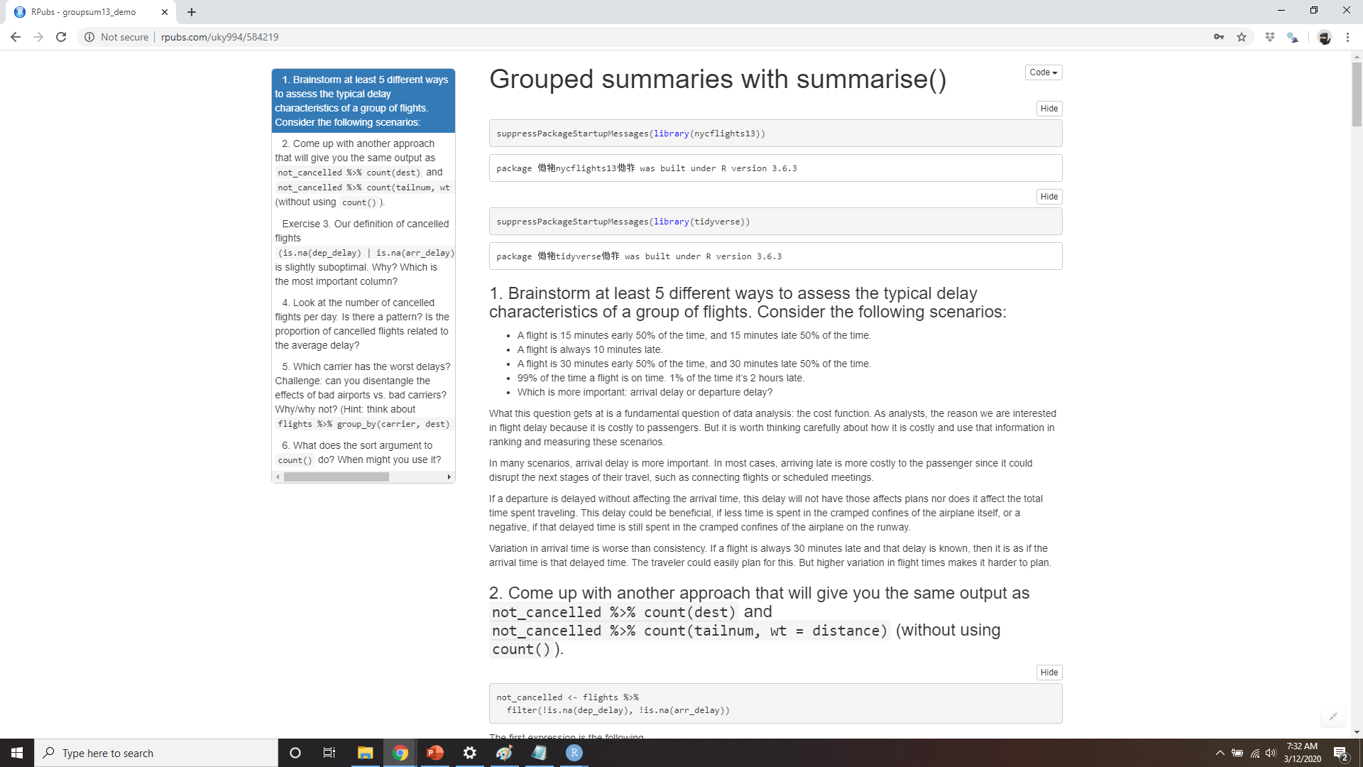
DEMO Grouped Summaries with summarize()
Notes:
https://rpubs.com/uky994/584219
Brainstorm at least five different ways to assess the typical delay characteristics of a group of flights. Consider the following scenarios:
A flight is 15 minutes early 50% of the time, and 15 minutes late 50% of the time.
A flight is always 10 minutes late.
A flight is 30 minutes early 50% of the time, and 30 minutes late 50% of the time.
99% of the time a flight is on time. 1% of the time it’s 2 hours late.
Which is more important: arrival delay or departure delay?
Come up with another approach that will give you the same output as not_cancelled %>% count(dest) and not_cancel led %>% count(tailnum, wt = distance) (without using count()).
Our definition of cancelled flights (is.na(dep_delay) | is.na(arr_delay) ) is slightly suboptimal. Why? Which is the most important column?
Look at the number of cancelled flights per day. Is there a pat‐ tern? Is the proportion of cancelled flights related to the average delay?
Which carrier has the worst delays? Challenge: can you disen‐ tangle the effects of bad airports versus bad carriers? Why/why not? (Hint: think about flights %>% group_by(carrier, dest) %>% summarize(n()).)
For each plane, count the number of flights before the first delay of greater than 1 hour.
What does the sort argument to count() do? When might you use it?

Slide 64
Grouped Mutates (and Filters)
Find the worst members of each group:
flights_sml %>%
group_by(year, month, day) %>%
filter(rank(desc(arr_delay)) < 10)
#> # A tibble: 3,306 x 7
#> # Groups: year, month, day [365]
#> year month day dep_delay arr_delay distance air_time
#> <int> <int> <int> <dbl> <dbl> <dbl> <dbl>
#> 1 2013 1 1 853 851 184 41
#> 2 2013 1 1 290 338 1134 213
#> 3 2013 1 1 260 263 266 46
#> 4 2013 1 1 157 174 213 60
#> 5 2013 1 1 216 222 708 121
#> 6 2013 1 1 255 250 589 115
#> # … with 3,300 more rows
Notes:
Grouping is most useful in conjunction with summarize(), but you can also do convenient operations with mutate() and filter():

Slide 65
Grouped Mutates (and Filters)
Find all groups bigger than a threshold:
popular_dests <- flights %>%
group_by(dest) %>%
filter(n() > 365)
popular_dests
#> # A tibble: 332,577 x 19
#> # Groups: dest [77]
#> year month day dep_time sched_dep_time dep_delay arr_time sched_arr_time
#> <int> <int> <int> <int> <int> <dbl> <int> <int>
#> 1 2013 1 1 517 515 2 830 819
#> 2 2013 1 1 533 529 4 850 830
#> 3 2013 1 1 542 540 2 923 850
#> # … with 3.326e+05 more rows, and 11 more variables: arr_delay <dbl>,
#> # carrier <chr>, flight <int>, tailnum <chr>, origin <chr>, dest <chr>,
#> # air_time <dbl>, distance <dbl>, hour <dbl>, minute <dbl>, time_hour <dttm>

Slide 66
Grouped Mutates (and Filters)
Standardize to compute per group metrics:
popular_dests %>%
filter(arr_delay > 0) %>%
mutate(prop_delay = arr_delay / sum(arr_delay)) %>%
select(year:day, dest, arr_delay, prop_delay)
#> # A tibble: 131,106 x 6
#> # Groups: dest [77]
#> year month day dest arr_delay prop_delay
#> <int> <int> <int> <chr> <dbl> <dbl>
#> 1 2013 1 1 IAH 11 0.000111
#> 2 2013 1 1 IAH 20 0.000201
#> 3 2013 1 1 MIA 33 0.000235
#> 4 2013 1 1 ORD 12 0.0000424
#> 5 2013 1 1 FLL 19 0.0000938
#> 6 2013 1 1 ORD 8 0.0000283
#> # … with 1.311e+05 more rows
Notes:
A grouped filter is a grouped mutate followed by an ungrouped filter. I generally avoid them except for quick and dirty manipulations: otherwise it’s hard to check that you’ve done the manipulation correctly.
‘
Functions that work most naturally in grouped mutates and filters are known as window functions (vs. the summary functions used for summaries). You can learn more about useful window functions in the corresponding vignette: vignette("window-functions").

Slide 67
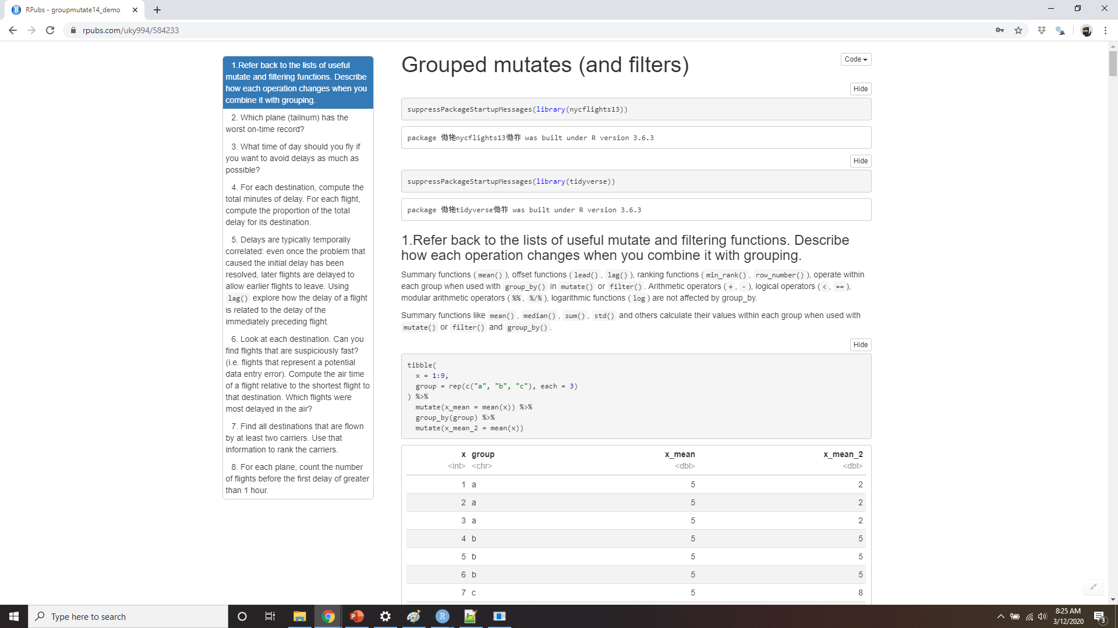
DEMO Grouped Mutates (and Filters)
Notes:
https://rpubs.com/uky994/584233
Refer back to the lists of useful mutate and filtering functions. Describe how each operation changes when you combine it with grouping.
Which plane (tailnum) has the worst on-time record?
What time of day should you fly if you want to avoid delays as much as possible?
For each destination, compute the total minutes of delay. For each flight, compute the proportion of the total delay for its destination.
Delays are typically temporally correlated: even once the problem that caused the initial delay has been resolved, later flights are delayed to allow earlier flights to leave. Using lag(), explore how the delay of a flight is related to the delay of the immediately preceding flight.
Look at each destination. Can you find flights that are suspiciously fast? (i.e. flights that represent a potential data entry error). Compute the air time of a flight relative to the shortest flight to that destination. Which flights were most delayed in the air?
Find all destinations that are flown by at least two carriers. Use that information to rank the carriers.
For each plane, count the number of flights before the first delay of greater than 1 hour.

